Slide 1
Chapter 5 Getting the Most from Class

Slide 2
Assess Your Strengths and Set Goals
Most students find that engagement makes them more enthusiastic and actually increases their learning.
What are your favorite classes and why?
Think about how to develop strategies and goals that relate to engagement in learning.

Slide 3
Become Engaged in Learning
Engaged students spend time and energy in and out of class to learn. Practice techniques of an active learner:
Talk with others
Ask questions in class
Seek out information beyond lecture material and required reading
Notes:
Instructors: Other strategies for becoming an active learner include:
Study in groups
Explore other information sources
Think about how the material relates to your own life

Slide 4

Valuable Skills of Active Learning
Working with others
Functioning independently and teaching yourself
Gaining sensitivity to cultural differences
What other valuable skills can you gain from active learning?
Notes:
Instructors: Use the question in the slide to generate a class discussion on the valuable skills that active learning provides. Other answers from the chapter are:
Improving your thinking, listening, writing, and speaking skills
Managing your time

Slide 5
Prepare for Class
Here are some strategies to help you before each class session:
Do assigned the reading
Pay careful attention to your course syllabus
Make use of additional materials
Warm up for class
Get organized

Slide 6

http://drive.google.com/file/d/1ck7D9H4olzDqFFOjkEphLGUZUMBBQNIU/view
Notes:
Possible discussion starter questions:
How can the syllabus help you prepare for class?
Why should you think about your classes and what you’re learning in them when you are not in class? How is this going to help you when you are in class?
Besides traditional studying, reading over material, and reviewing notes, what are some valuable strategies you might use to prepare for class?

Slide 7
Participate in Class
Participation is the heart of active learning.
To really learn, you must listen carefully, talk about what you are learning, write about it, connect it to past experiences, and make what you learn part of yourself.

Slide 8
Listen
Knowing how to listen in class can help you get more out of what you hear and improve your understanding. Some suggestions to listen critically and with an open mind:
Be ready for the message
Listen to main concepts and central ideas
Listen for new ideas
Notes:
Other suggestions in the chapter include:
Repeat mentally
Determine the importance of what you hear
Keep an open mind
Ask questions
Sort, organize, and categorize

Slide 9
Speak Up
Speaking in class is part of participation. Try some of these techniques for class participation:
Sit close to the front
Focus on the lecture and class discussions
Raise your hand when you don’t understand
Notes:
Other techniques include:
Speak up in class
Don’t bluff
If you recently read something relevant, bring it in

Slide 10
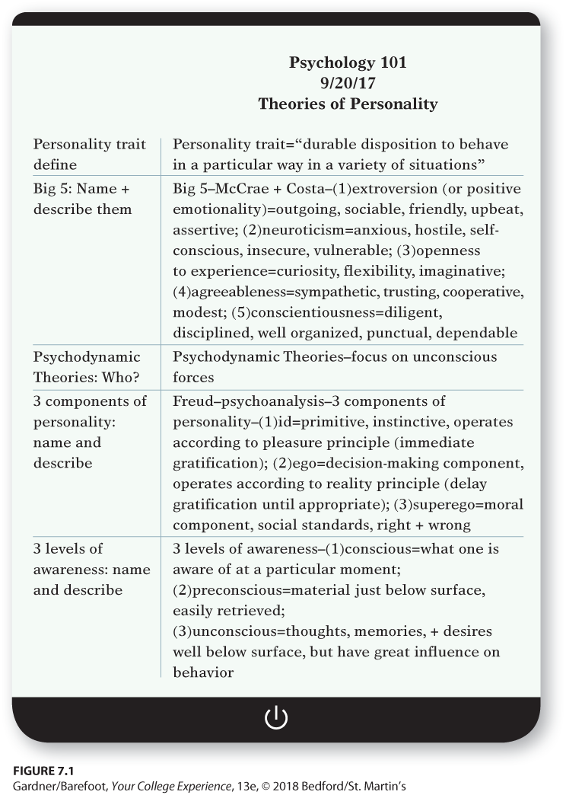
Note-Taking Formats: Cornell Format
Create a “recall” column
Write only in the wider column as your take notes
Use the recall column for main ideas and important details when going back through notes

Slide 11
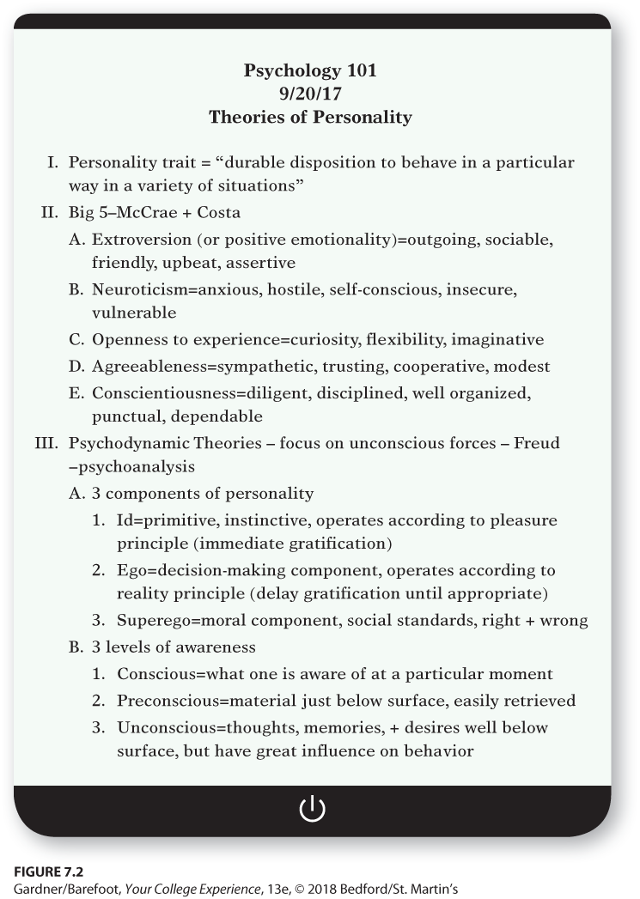
Note-Taking Formats: Outline Format
Roman numerals for main ideas
Uppercase letters for ideas related to main ideas
Arabic numerals and then lowercase letters for descending levels

Slide 12
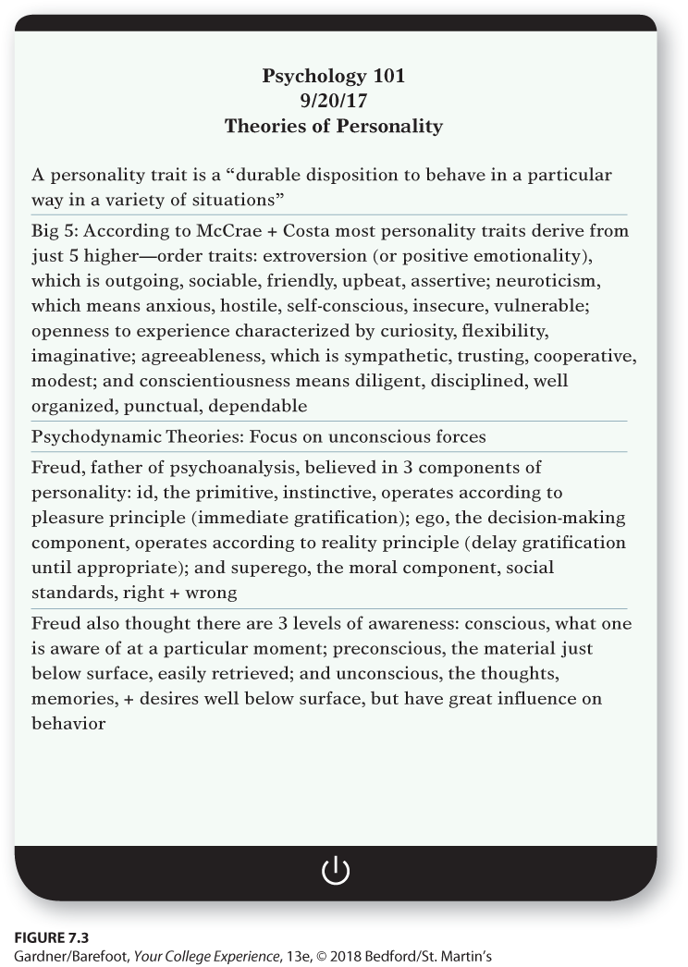
Note-Taking Formats: Paragraph Format
Write summary paragraphs as you take notes
Might not work well for class notes because it’s difficult to summarize a topic until your instructor has covered it completely.

Slide 13

Note-Taking Formats: List Format
List terms and definitions
List facts
List sequences
This method is easy to use with the Cornell format.

Slide 14
Note-Taking Techniques
Whatever method you choose, there are important steps to remember:
Identify main ideas
Don’t write down everything.
Don’t be thrown by a disorganized lecturer.
Which method do you think is best and why?
Notes:
Other steps to remember include:
Keep notes and supplementary materials for each course separate.
Download notes, outlines, diagrams, charts, and graphs and bring them to class.
If handouts are distributed, label them and place them near your notes.

Slide 15

http://drive.google.com/file/d/1n-7GR40vE6kwm_99w2tMONAY2_aBt0Ix/view
Notes:
Possible discussion starter questions:
How do you figure out what a lectures main idea is? How will figuring out the main idea help you when taking notes?
Why is it important to listen carefully when taking notes?
What is your best note taking method? Why do you think it works best for you?

Slide 16

Taking Notes in Nonlecture Courses
Always be ready to change note-taking methods based on the situation:
Record information presented by both the instructor and classmates.
Consider all reasonable ideas
The way you organize notes depends on the purpose or form of the discussion.

Slide 17
Taking Notes in Science and Mathematics Courses
Taking notes in math and science courses can be different from taking notes in other classes. Tips to remember are:
Write down equations, formulas, diagrams, charts, graphs, and definitions.
Write your instructor’s words precisely.
Write down all worked problems and examples step by step.
Notes:
Other tips include:
Take notes in pencil or erasable pen.
Listen carefully to students’ questions and the instructor’s answers.
Highlight important points and questions to revisit.
Refer to the textbook after class.
Keep your notes until after you graduate or even longer.
Use standard symbols, abbreviations, and scientific notation.

Slide 18

Using Technology to Take Notes
Take notes on a laptop, tablet, or other mobile device.
If you handwrite notes, entering them on a computer after class is a helpful review.
Some students find it advantageous to record lectures.
Do you prefer to take notes on a digital device or handwrite them?

Slide 19
Tech Tip: Take Better Notes in Better Ways
There are many ways to take notes using technology:
Word allows you to easily format and mark up notes.
Excel is good for any class involving calculations or financial statements.
PowerPoint can be invaluable for visual learners.
There are numerous apps for note taking
Notes:
Some apps for note taking include:
Pocket
Evernote
CamScanner
Scan Edit
Tiny Tap
StudyBlue

Slide 20
Review Your Notes
We forget much of the information we receive within twenty-four hours. The decline of memory over time is known as the forgetting curve. Strategies for remembering important details:
Write down main ideas.
Repeat your ideas out loud.
Review notes from the previous class just before the next class session.

Slide 21

Comparing Notes
There are benefits to comparing notes:
Probably take better notes
See if notes are clear and organized
See whether you agree on what the most important points are
Be aware that merely copy another student’s notes does not benefit you as much as comparing notes.

Slide 22
Class Notes and Homework
Once you have reviewed your notes, use them to complete homework assignments. Follow these steps:
Do a warm-up for your homework.
Do any assigned problems, and answer any assigned questions.
Don’t give up too soon.
Complete your work.

Slide 23
Reflection
Identify which note-taking method might work best for you.
It is easier to remember and learn new material when you connect it to something you already know or have experienced. Which of your classes connects most directly to something you learned in the past or something that happened to you?

